Slide 1

Cyclistic Bike-Share Case Study
Presented By: Andrew Cha

Slide 2
Company
Data Source
License
Cyclistic is a fictional company inspired by Divvy Bikes, a real-life bike-sharing company located in Chicago. The datasets used closely resemble real-world bike-sharing data and are applicable for addressing the business questions in this case study.
The public dataset is sourced from Divvy Bikes, operated by Lyft and owned by the City of Chicago. This data was obtained from the 'Divvy Public Dataset' website.
The dataset was provided by Motivate International Inc. under the Divvy Data License Agreement. Use of this public dataset is subject to the terms and conditions outlined in the Divvy Data License Agreement.

Slide 3
Table of contents
1
Introduction
2
Analytical Framework
3
Key Findings
4
Actionable Insights
5
Marketing Strategies
6
Conclusion

Slide 4
Introduction
1
Overview of
Cyclistic Bike-Share Analysis

Slide 5

Introduction to Cyclistic
Established in 2016, Cyclistic's bike-share initiative has evolved into a robust network featuring 5,824 bicycles stationed at 692 locations across Chicago. Enhanced with geo-tracking capabilities, these bikes allow users the freedom to unlock and return them at any station within the expansive network. Cyclistic's marketing strategy revolves around its adaptable pricing structures, encompassing single-ride passes, full-day passes, and annual memberships. Casual riders, opting for single-ride or full-day passes, constitute one segment, while member riders, who enroll in annual memberships, constitute another.

Slide 6
Insights For Growth
Acknowledging the superior profitability of annual members over casual riders, Cyclistic's marketing manager, Moreno, aims to pivot towards maximizing annual membership subscriptions for future growth. The objective is to convert casual riders into annual members by leveraging their existing familiarity with the Cyclistic program.
To accomplish this, Moreno's team seeks to delve into the distinctions between annual members and casual riders, unearth the motivations prompting casual riders to purchase memberships, and evaluate the potential impact of digital media on marketing strategies. Through a comprehensive analysis of Cyclistic's historical bike trip data, the team aims to extract actionable insights to inform their marketing endeavors.

Slide 7
Exploring Cyclistic Bike Types
Classic bikes offer a traditional and reliable biking experience, ideal for short to medium-distance trips in the city.
Classic Bike
Docked bikes provide convenient access and secure parking at designated docking stations across the city.
Docked Bike
Electric bikes feature pedal-assist technology for an extra boost during rides, catering to users seeking efficient and sustainable transportation options.
Electric Bike

Slide 8
Cyclistic Pricing Overview
Single
Rides
$1 to unlock,
And $0.18 per min
Day
Pass
$18.10 per day
Annual
Membership
$143.90 per year,
Or $11.99 per month
The Single Ride option costs only $1 and covers the initial 30 minutes of a ride on a classic bike.
The Day Pass includes unlimited 3-hour rides with classic bikes throughout a 24-hour duration. Exceeding the initial 3-hour period results in an additional charge of $0.18 per minute for classic bikes while upgrading to an electric bike incurs a supplementary fee of $0.44 per minute.
The Annual Membership provides unrestricted 45-minute rides for an entire year with round-the-clock access. Going beyond the 45-minute limit results in an extra fee of $0.18 per additional minute, and choosing an electric bike incurs an additional charge of $0.18 per minute.
*Disclaimer: The pricing information presented is sourced from the Divvy Bikes website for reference purposes, given that Cyclistic is a fictitious entity.

Slide 9
Scenario Overview
The Analyst Team aims to understand the different usage patterns of casual and annual members.
I am a Junior Data Analyst in the Marketing Analyst Team at Cyclistic.
Approach
Role
The Director of Marketing believes the company’s future success relies on maximizing the number of annual memberships.
Objective
The team plans to analyze trip data from 2023 to understand user group differences, motivations, and digital media's impact.
Goal

Slide 10
Key Questions
Question 3
Question 1
How can Cyclistic use Digital Media to influence Casual Riders to become Members?
How do Annual Members and Casual Riders use Cyclistic Bikes differently?
Why would Casual Riders buy Cyclistic Annual Memberships?
Question 2

Slide 11
Business Task
Design a marketing strategy to convert casual riders into annual members.
By analyzing Cyclistic's bike trip data to discern usage disparities between casual riders and annual members, we can craft a marketing strategy that drives the conversion, thus fueling growth and profitability.

Slide 12
2
Analytical Framework
Data Collection and Analysis Approach

Slide 13
Data Insights
Utilizing the software RStudio as the method of analysis.
Cyclistic Bike-Share Data consists of 12 CSV files representing January 2023 through December 2023.
After concatenating and transforming the new data frame, it now contains 5,459,091 rows and 22 columns.
The data frame contains information regarding ride id, user types, rideable types, ride location, and ride timestamps.
Notes:
Curve bo

Slide 14
3
Key
Findings
Insights into User Behavior

Slide 15
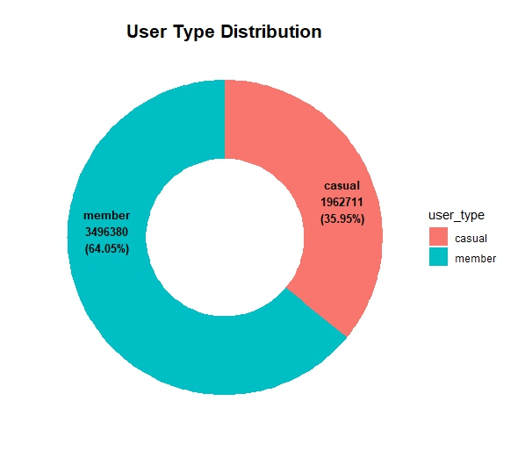
User Type Distribution
The chart illustrates the volume of rides, amounting to 5,459,091 rides in 2023.
Casual users contribute to 35.95% of the total rides, accounting for 1,962,711 rides. While this represents a smaller proportion of bike share usage compared to member users, it still signifies a significant portion of the overall activity.
In contrast, member users constitute a substantial portion, representing 64.05% of the total rides with 3,496,380 rides.

Slide 16
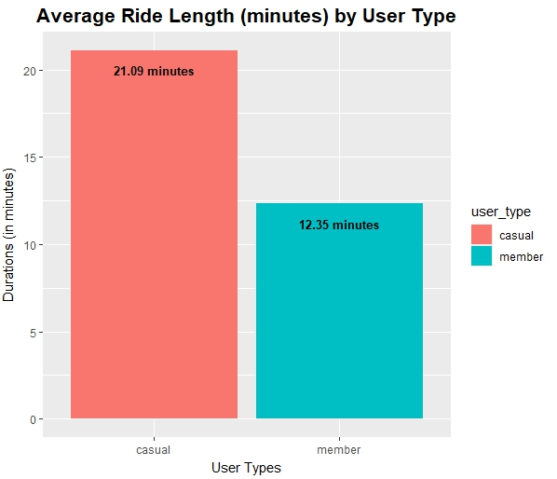
Average Ride Length by User Type
Casual users, with an average ride length of 21.09 minutes, demonstrate a longer duration for bike rides.
In contrast, member users have an average ride length of 12.35 minutes.
This contrast suggests that casual users may utilize the bike-sharing service for longer or leisurely trips, whereas members are more inclined to use it for shorter, routine commutes.

Slide 17
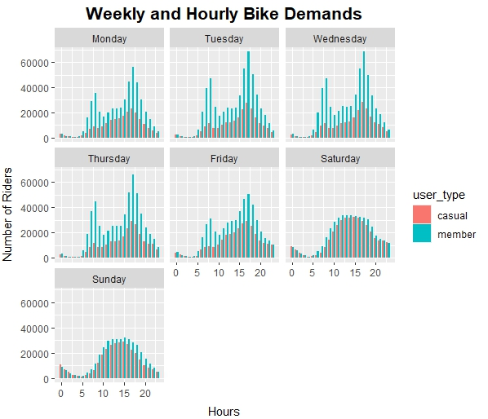
Weekly and Hourly Bike Demands
Casual users prefer leisurely bike rides, peaking during mid-morning around 10 AM (9,148 rides) and 2-4 PM (averaging 18,357 rides) on weekdays, and 3-7 PM on Fridays (averaging 24,807 rides). Weekends peak from 10 AM to 4 PM (averaging 27,782 rides), reflecting recreational preferences.
Member users commute heavily on weekdays, with peaks at 7-9 AM (averaging 34,451 rides) and 5-7 PM (averaging 49,879 rides). Friday evenings are active at 3-6 PM (averaging 44,260 rides). Weekends show consistent but reduced demand at 10 AM - 2 PM (averaging 30,839 rides).

Slide 18
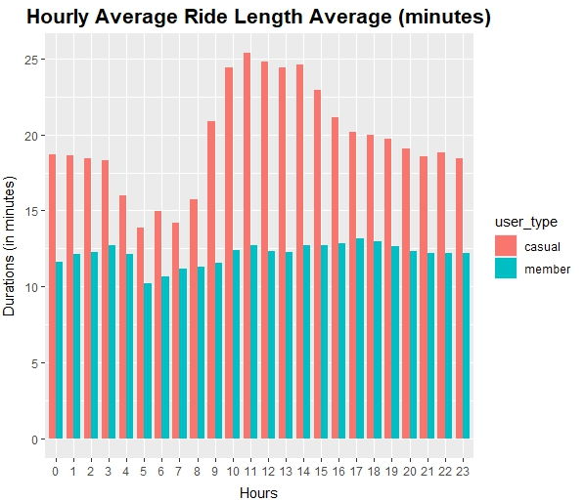
Hourly Average Ride Length
Casual users show varying ride durations, with the shortest at 5 AM (13.85 minutes) and peaking at 11 AM (25.37 minutes). This peak occurs between 10 AM and 2 PM. Despite a gradual decline afterward, durations remain relatively high compared to early morning.
In contrast, member users maintain consistent ride lengths throughout the day, with the lowest in the early morning at 5 AM (10.21 minutes) to the highest during evening rush hours at 5 PM (13.15 minutes). Members have shorter durations overall compared to casual users, especially noticeable during midday.

Slide 19
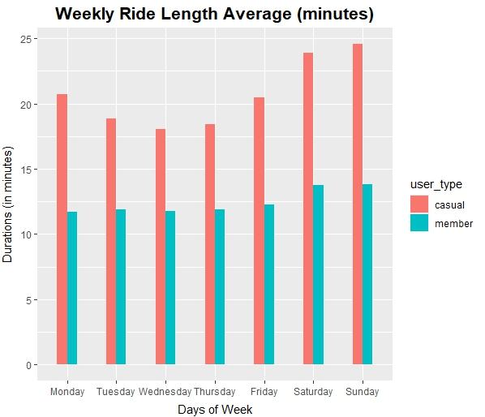
Weekly Average Ride Length
Casual users, trend supports the notion of weekend leisure or recreational activities, with Sundays (24.58 minutes) recording the lengthiest rides. Transitioning from the weekends to weekdays, Wednesdays (18.04 minutes) mark as the lowest ride durations, indicating a shift towards shorter trips during the middle of the week.
Member users also exhibit longer rides on Sundays (13.79 minutes), suggesting a potential overlap in non-commuting usage during weekends. However, member users experience their shortest rides on Mondays (11.72 minutes), possibly indicating a return to routine commuting after the weekend.

Slide 20
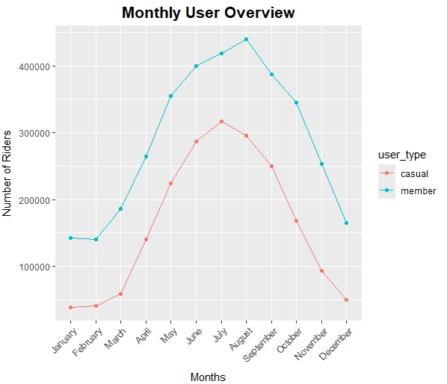
Monthly User Overview
Casual users peak in July (316,555 rides) and hit their low in January (38,204 rides), indicating a preference for leisurely rides during warmer months.
Member users also peak in August (439,658 rides) and hit their low in February (140,067 rides). Their usage remains consistent throughout the year, suggesting varied usage beyond commuting.
Member users maintain higher usage levels compared to casual users year-round, especially evident during winter.

Slide 21
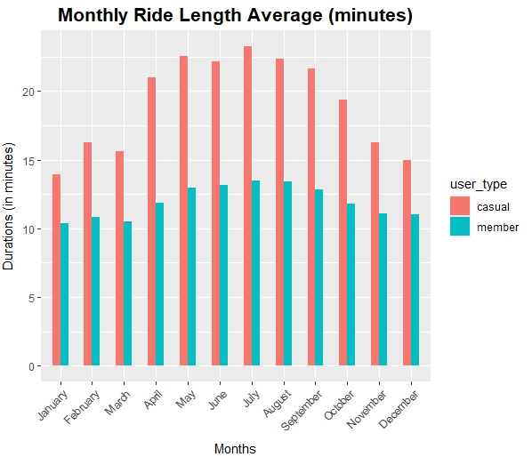
Monthly Average Ride Length
Casual users' longest rides peak in July (23.25 minutes) and shortest in January (13.91 minutes), indicating a preference for leisurely rides in warmer months.
Member users also experience longer rides in July (13.51 minutes) and shortest in January (10.41 minutes), like casual users. This suggests differing riding habits due to factors like commuting needs.
Both groups consistently have shorter rides in winter and longer in summer, reflecting weather impact. Casual users consistently have longer rides compared to members.

Slide 22
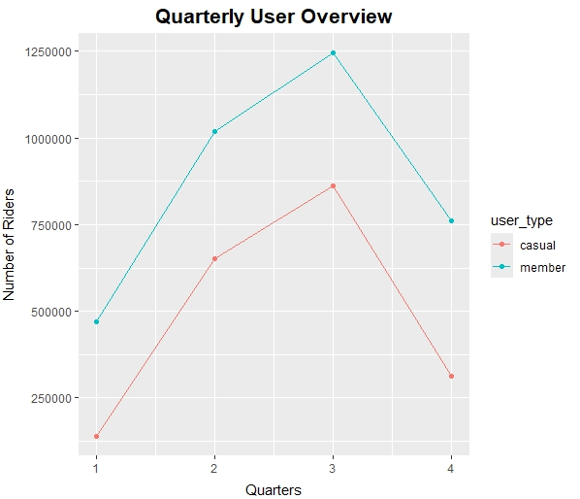
Quarterly User Overview
Casual users peak in the 3rd quarter (July-September) with 861,959 rides and hit their lowest in the 1st quarter (January-March) with 138,591 rides, likely influenced by seasonal conditions.
Member users also peak in the 3rd quarter (July-September) with 1,245,624 rides and hit their lowest in the 1st quarter (January-March) with 469,922 rides, showing similar seasonal patterns.
Member users consistently maintain higher ride numbers compared to casual users, potentially due to commuting habits less affected by weather.

Slide 23
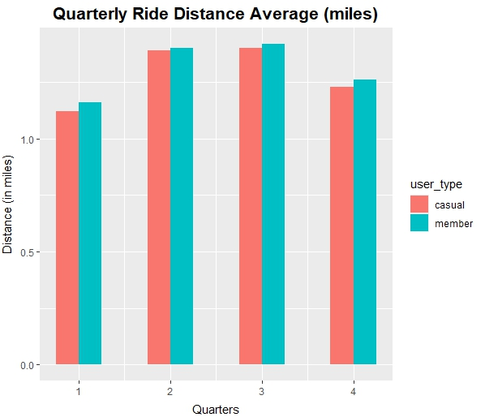
Quarterly Average Ride Distance
Casual users have the longest average distance in the 3rd quarter (1.40 miles) and the shortest in the 1st quarter (1.12 miles), reflecting summer preferences for longer rides.
Member users also show this trend, with longest average distances in the 3rd quarter (1.42 miles) and shortest in the 1st quarter (1.16 miles), indicating weather influence.
Member users consistently have slightly longer average ride distances, suggesting more practical usage, potentially involving longer commutes.

Slide 24
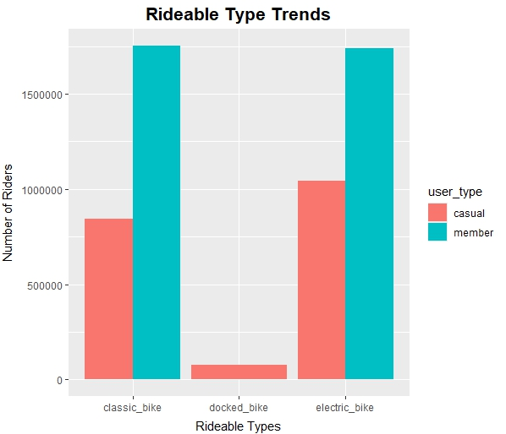
Rideable Type Trends
Among casual users, electric bikes are the most popular (1,043,904 rides), followed by classic bikes (843,957 rides), and then docked bikes (74,850 rides), possibly due to convenience for leisurely rides.
Member users prefer classic bikes (1,754,117 rides) slightly more than electric bikes (1,742,263 rides), likely for commuting needs or cost considerations.
Docked bikes are the least preferred option for both user groups, possibly due to inconvenience in returning them to docking stations.

Slide 25
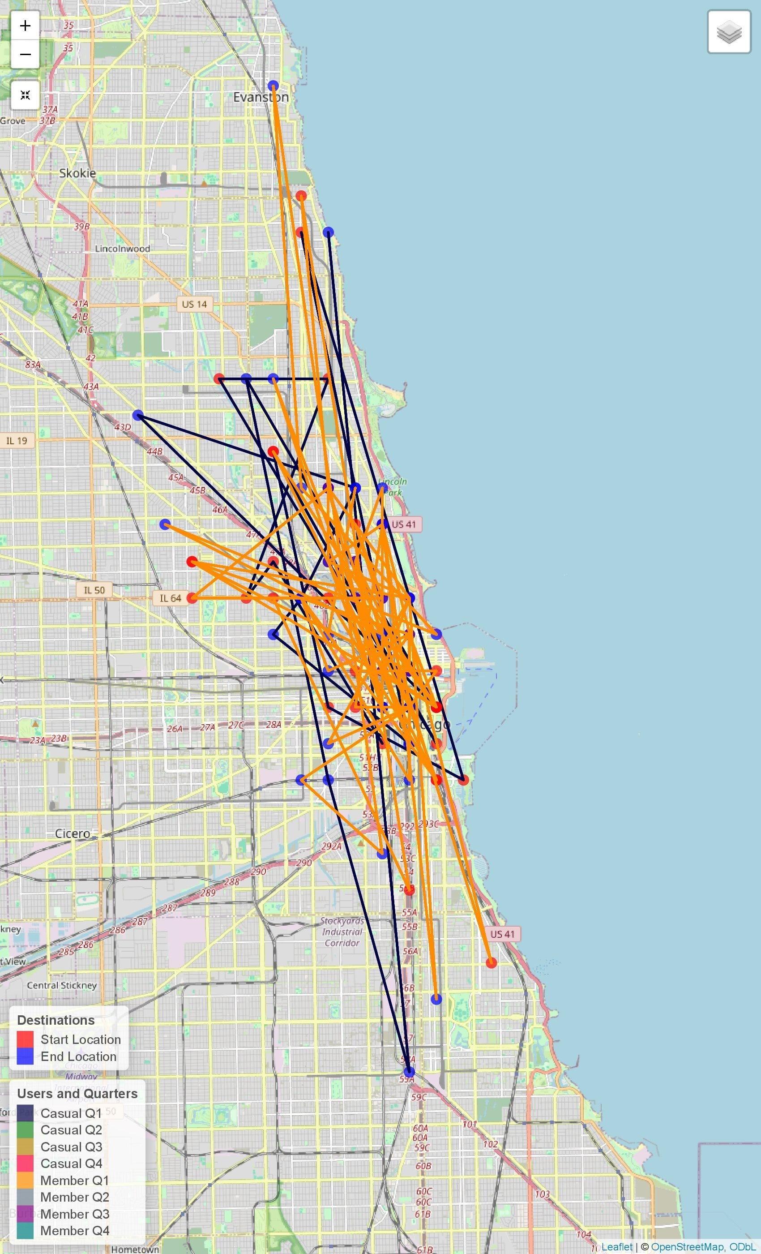
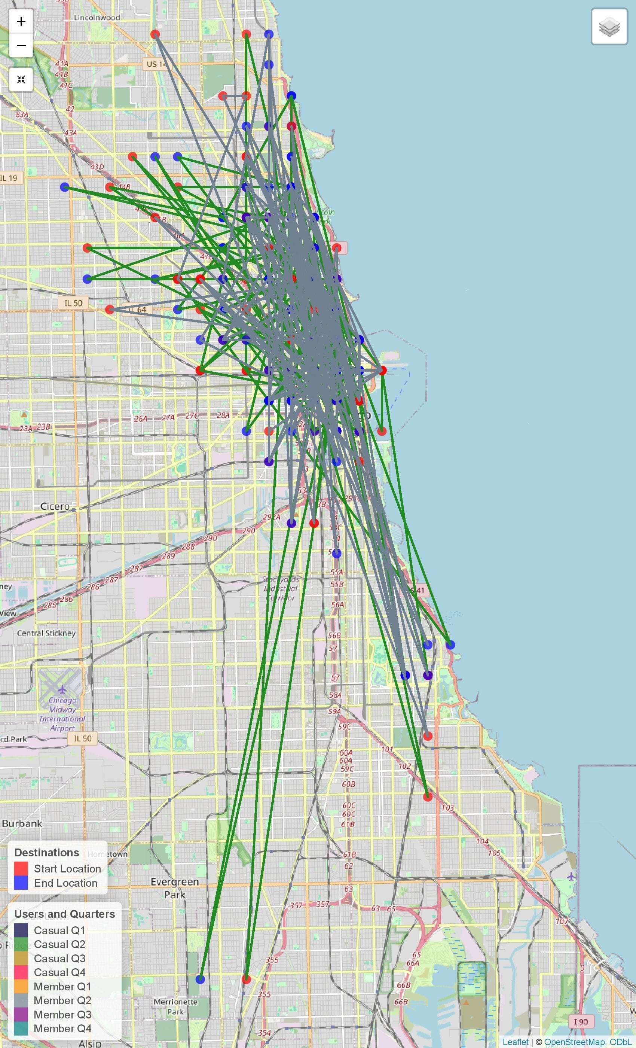
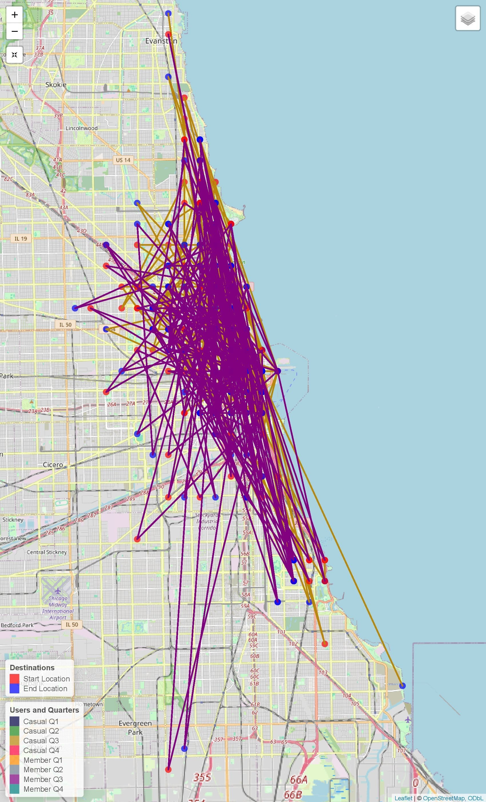
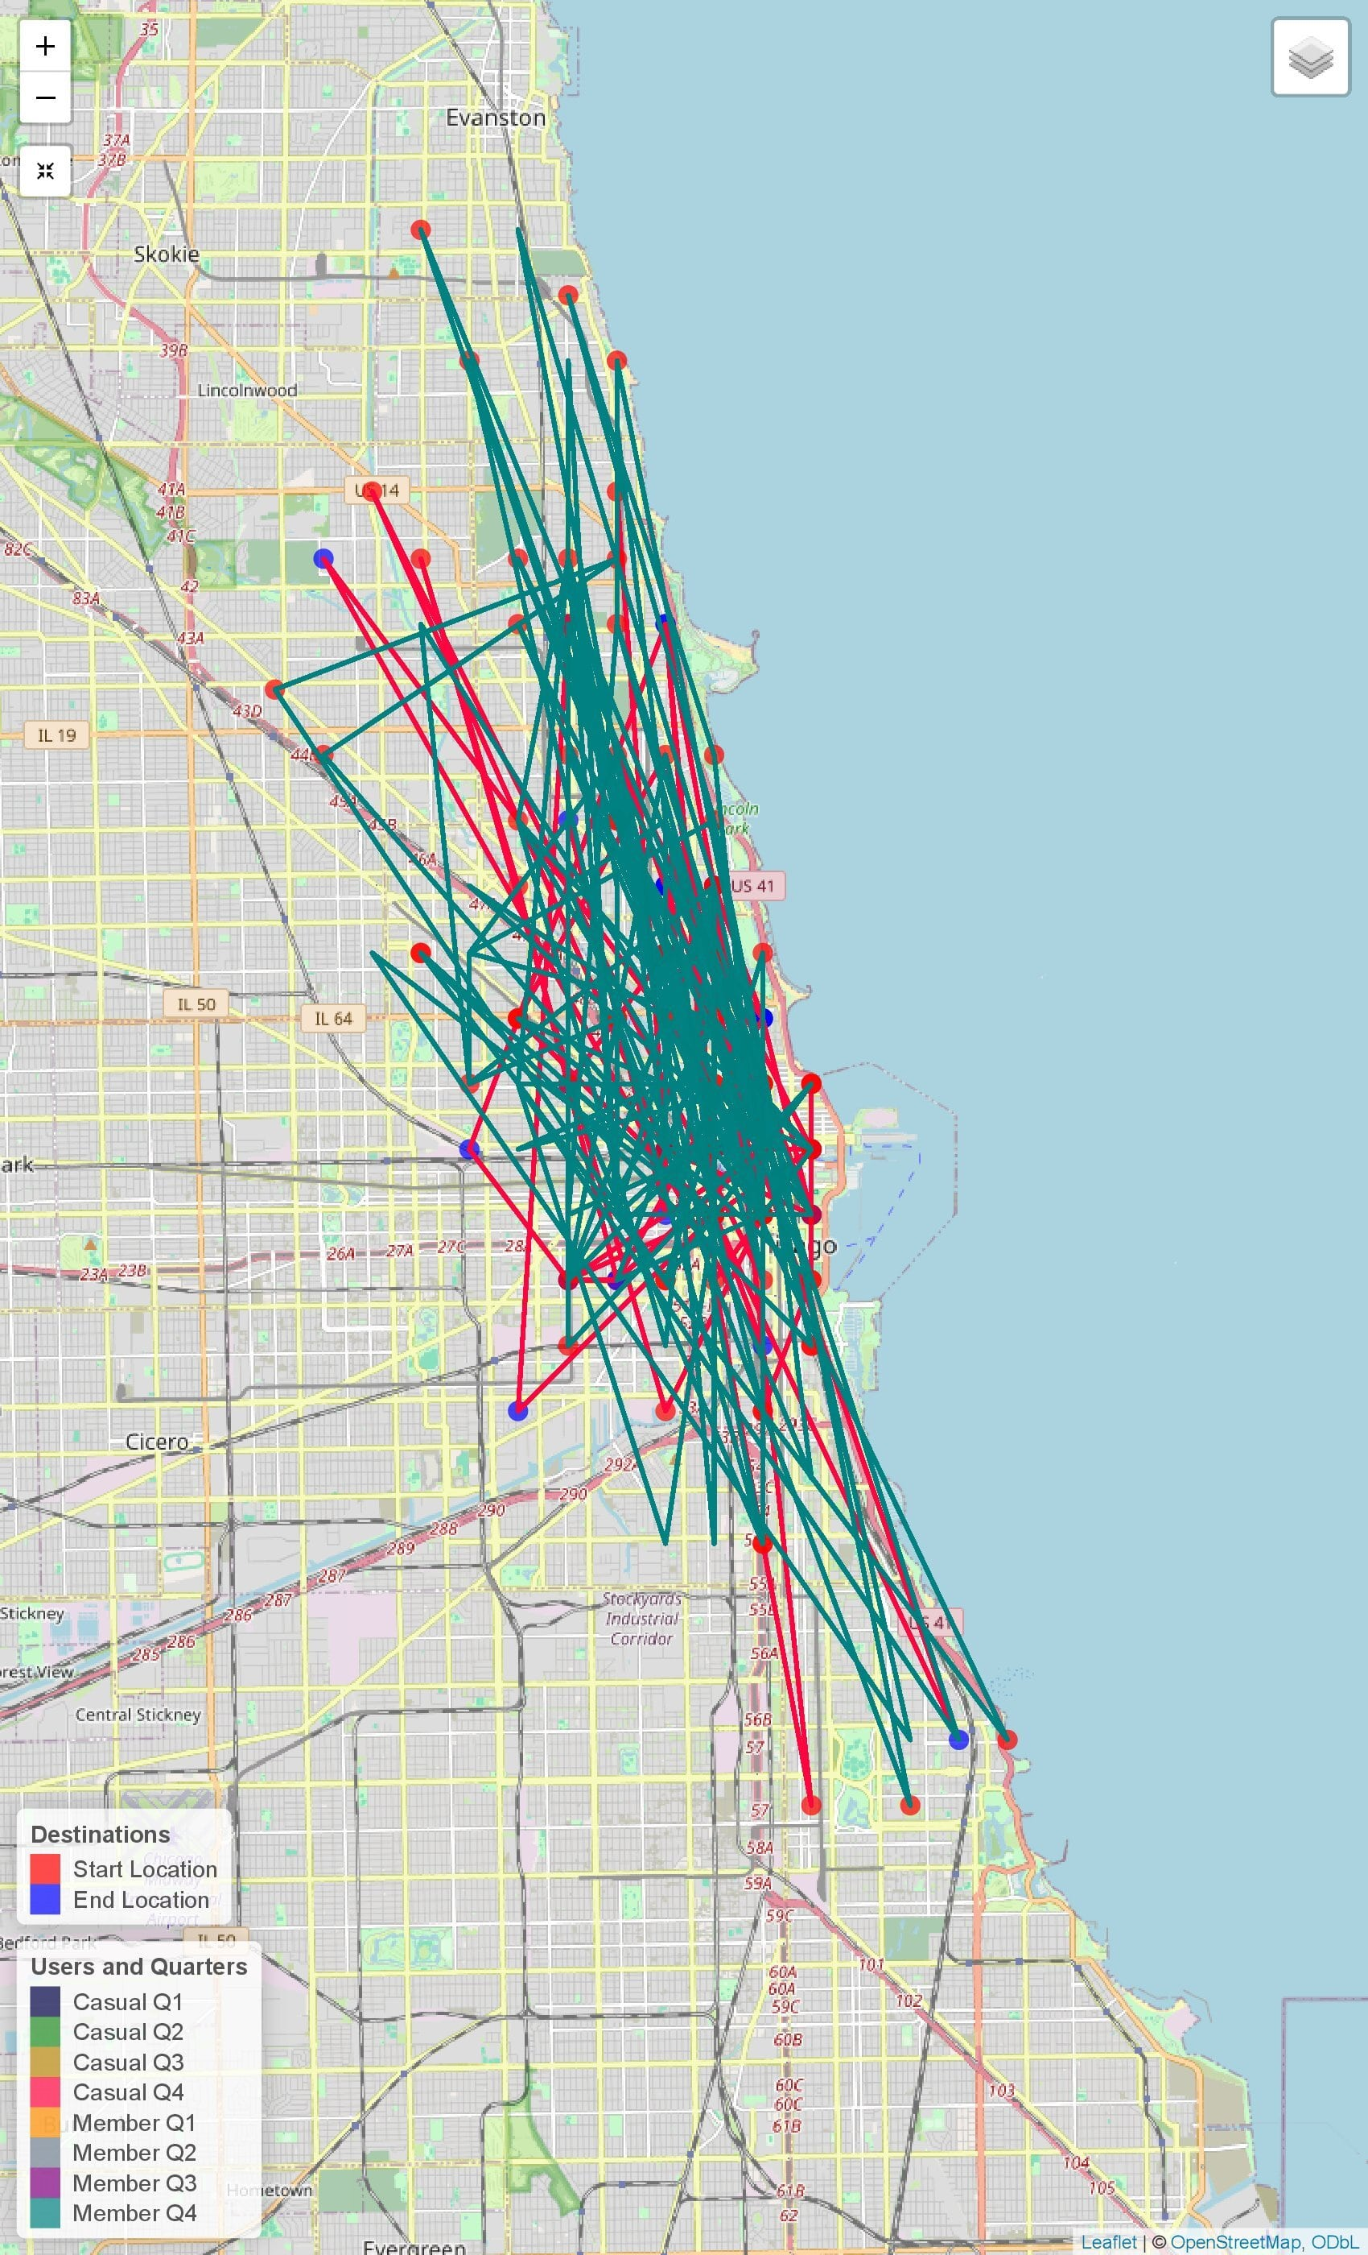
User Type Quarterly Destination Interactive Map
Quarter 1
Quarter 2
Quarter 3
Quarter 4
Casual users prefer shorter leisure rides, mainly on electric bikes within a range of 0.51 to 5.04 miles. Geographical influences shape usage, with business districts busy on weekdays and parks more active on weekends. Seasonal variations impact usage, with lower bike usage in Q1 due to colder weather and peak activity in Q3 with longer rides spanning up to 5.04 miles on electric bikes.
Member users prefer classic bikes, but demand for electric bikes increases in the second half of the year. In Q1 and Q2, shorter distances ranging from 0.51 to 1.72 miles suggest routine commuting or shorter recreational rides, while Q3 and Q4 indicate more leisurely rides, possibly on electric bikes during warmer months. Popular stations like "Clark St & Wrightwood Ave" consistently witness high trip volumes. Members commute predictably on weekdays, while casual users opt for longer leisure rides

Slide 26
4
Actionable Insights
Navigating Business Challenges

Slide 27
Key Question 1
Annual members use Cyclistic bikes primarily for commuting, with consistent weekday usage and preference for classic bikes.
They maintain stable ride counts month-to-month, with slightly higher usage during warmer months.
Casual riders use Cyclistic bikes for leisure, showing increased usage on weekends and during warmer quarters.
They prefer electric bikes for longer excursions and display more fluctuation in bike usage, with higher ride counts during warmer months.
Seasonal variations impact both groups, but casual riders' usage is more influenced by weather conditions, peaking in warmer months.
Overall, these patterns highlight distinct needs and motivations within Cyclistic's user base, with annual members relying on daily transportation and casual riders opting for recreational biking.
Question 1
How do Annual Members and Casual Riders use Cyclistic Bikes differently?

Slide 28
Key Question 2
Casual riders may find Cyclistic annual memberships appealing due to potential cost savings and enhanced convenience.
Unlimited rides without additional costs per trip could make an annual membership economically favorable compared to pay-as-you-go options.
Seamless bike access through a membership key or app streamlines the biking experience, eliminating the need to purchase individual passes for each ride.
Member-exclusive benefits, such as priority access to bikes during peak hours, discounts on accessories, and participation in special events or promotions, further incentivize casual riders to commit to an annual membership.
The added value and sense of belonging offered by annual memberships can be attractive to casual riders, despite being occasional users.
Question 2
Why would Casual Riders buy Cyclistic Annual Memberships?

Slide 29
Key Question 3
Cyclistic can use digital media for targeted advertising across social platforms and channels to showcase membership benefits to casual riders.
Engaging content like testimonials and guides can educate casual riders on the value of membership and inspire them to transition.
Incentivized referral programs and interactive campaigns offer opportunities for engagement and conversion.
Email marketing can nurture leads and maintain communication with potential members, reinforcing membership benefits.
A comprehensive digital media approach can influence casual riders to embrace membership, fostering long-term engagement and loyalty within Cyclistic's biking community.
Question 3
How can Cyclistic use Digital Media to influence Casual Riders to become Members?

Slide 30
5
Marketing Strategies
Converting Casual Riders to
Annual Members

Slide 31
Top 3 Recommendations
Tailed Messaging
Promotional Incentives
Personalized Offers
Crafting targeted marketing campaigns that directly address the needs and preferences of casual riders can be highly effective. By highlighting the benefits of annual memberships in a way that resonates with their leisure-oriented usage patterns, you're more likely to capture their attention and interest.
Offering limited-time promotions or discounts on annual memberships can create a sense of urgency and encourage casual riders to make the switch. Special introductory rates or bundled benefits can sweeten the deal and provide that extra push needed for conversion.
Leveraging Cyclistic's trip data to personalize offers based on individual riding behaviors. By tailoring promotions to target riders who frequently use the service during weekends or warmer months, you're addressing their specific needs and demonstrating the value of membership for their leisure activities.

Slide 32
6
Conclusion
Summary of Key Takeaways, Work Cited, and Others

Slide 33
Key Takeaways
Preferences and Motivations
Annual members primarily use Cyclistic bikes for commuting purposes, with consistent weekday usage.
Casual riders opt for leisurely outings, showing peaks in usage during weekends and late afternoons.
Annual members prefer classic bikes for practical commuting, while casual riders favor electric bikes for convenience and comfort during leisure rides.
Differences in trip durations and seasonal variations underscore divergent needs between user groups.
Usage Patterns
Marketing Strategies
Engagement and Retention
Tailored marketing strategies emphasizing the benefits of membership can encourage casual riders to convert into annual members.
Promotional incentives, personalized offers, and engaging content can enhance the appeal of annual memberships and drive conversion rates.
Engaging casual riders through educational content, interactive campaigns, and strategic partnerships can foster long-term engagement.
Continuous monitoring and optimization of marketing strategies based on data insights can improve customer retention and satisfaction.

Slide 34
Source Citation
Resources
Website
Divvy Data
Annual Membership
Purchasing a Day Pass
Take a Single Ride
Meet the Bikes
Pricing
What is a Station? A Dock? A Kiosk?
Additional Resources
License
Location
Presentation
Images

Slide 35


Andrew Cha
andrewtcha07@gmail.com
linkedin.com/in/andrew-cha/
github.com/chaanalyst

Slide 36
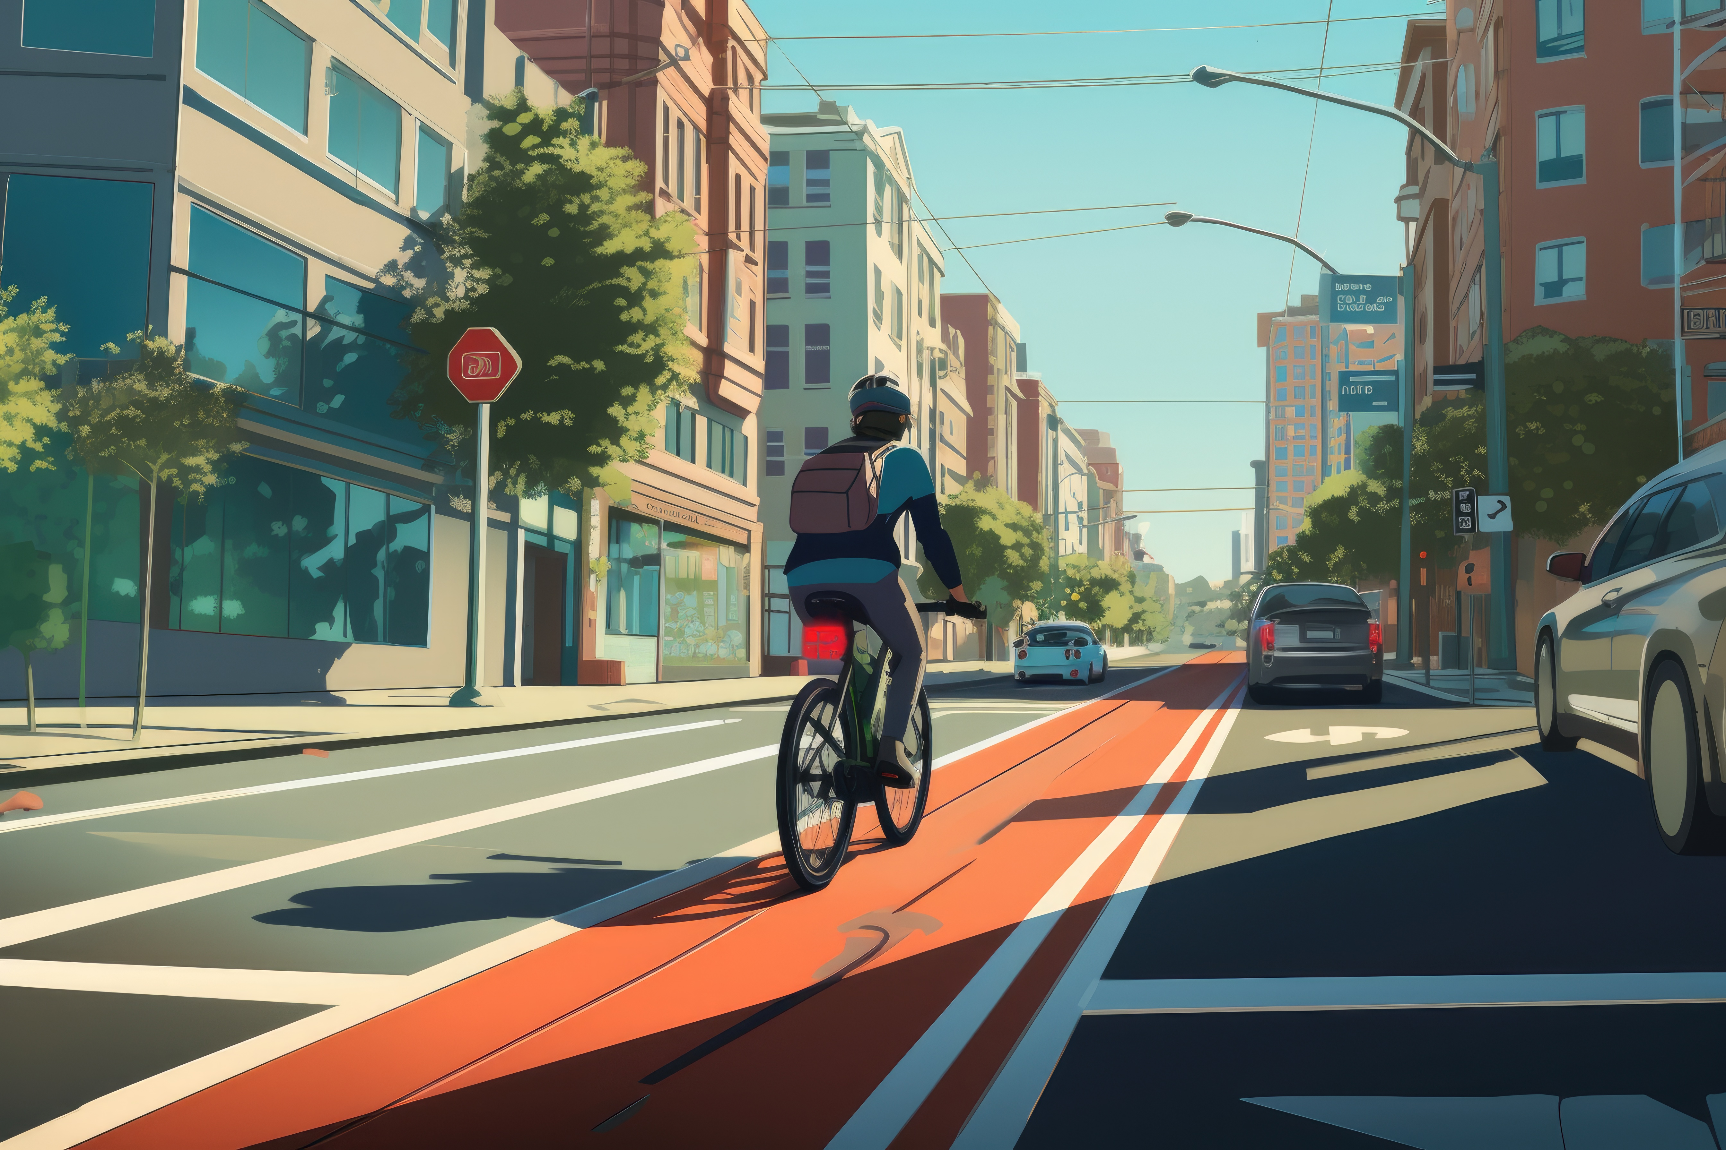
Thank You!

